Slide 1
CEN 3078 Computer Security
Module 2 – Application and Network Attacks

Slide 2
TCP fundamental
Attacks on the TCP protocol
Denial-of-Service attack
SQL injection attack
Cross-side scripting attack
Miscellaneous: Heartbleed bug and attack, Ransomware, Cryptojacking
Module 2

Slide 3
Attack on connect – TCP SYN Flooding
Attack to terminate - TCP Reset Attack
Understanding Cookies
Attack during session – TCP Hijacking Attack
Module 2
Attacks on the TCP protocol

Slide 4
Attack on connect – TCP SYN Flooding
Attack to terminate - TCP Reset Attack
Understanding Cookies
Attack during session – TCP Hijacking Attack
Module 2
Attacks on the TCP protocol

Slide 5
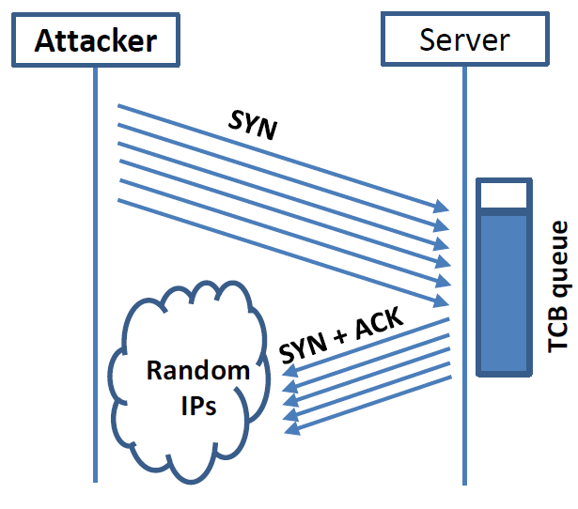
SYN Flooding Attack
Idea : To fill the queue storing the half-open connections so that there will be no space to store TCB for any new half-open connection, basically the server cannot accept any new SYN packets.
Steps to achieve this : Continuously send a lot of SYN packets to the server. This consumes the space in the queue by inserting the TCB record
Do not finish the 3rd step of handshake as it will dequeue the TCB record
When flooding the server with SYN packets, attackers use random source IP addresses; otherwise the attacks may be blocked by the firewalls…
5

Slide 6
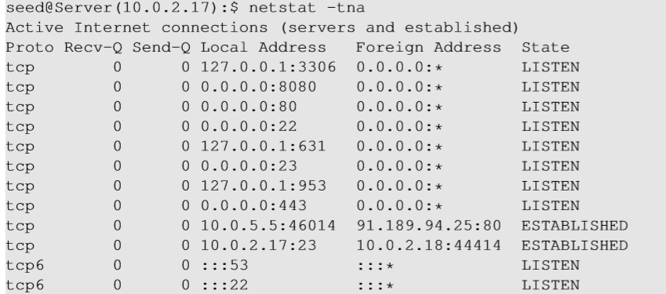
Launching SYN Flooding Attack – Before Attacking
Check the TCP states
TCP States
LISTEN: waiting for TCP connection.
ESTABLISHED: completed 3-way handshake
SYN_RECV: half-open connections
6

Slide 7
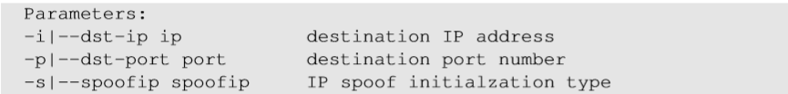
SYN Flooding Attack – Launch the Attack
Turn off the SYN Cookie countermeasure:
$sudo sysctl -w net.ipv4.tcp_syncookies=0
Targeting telnet server port 23 with SYN packets
Launch the attack using netwox
Result
Note ssh at server port 22 will still work, but not telnet
NOTE: In your SEED Lab-2, you will use Scapy for launching a SYN Flooding attack
7
Notes:
Not using Netwox but Scapy python code
https://web.ecs.syr.edu/~wedu/Teaching/cis758/netw522/netwox-doc_html/tools/76.html

Slide 8
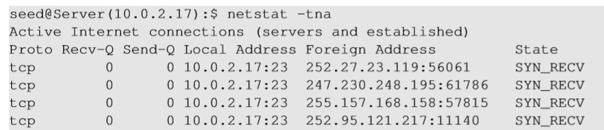
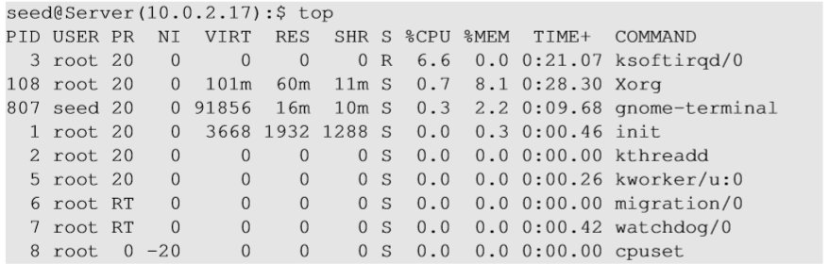
SYN Flooding Attack - Results
Using netstat command, we can see that there are a large number of half-open connections on port 23 with random source IPs
Using top command, we can see that CPU usage is not high on the server machine. The server is alive and can perform other functions normally, but cannot accept telnet connections only
8
Notes:
Attack should be done on 22 or 80 – each port SYN attack is possible – in above example, only 23 is blocked

Slide 9
Countermeasures: SYN Cookies
After a server receives a SYN packet, it calculates a keyed hash (H) from the information in the packet using a secret key that is only known to the server
This hash (H) is sent to the client as the initial sequence number from the server. H is called SYN cookie
The server will not store the half-open connection in its queue when SYN Cookie kicks-in after a certain number of SYN packets are received; instead information is put in the packet to see if it is a real connection to get information back
If the client is an attacker, H will not reach the attacker
If the client is not an attacker, it sends H+1 in the acknowledgement field
The server checks if the number in the acknowledgement field is valid or not by recalculating the cookie
9

Slide 10
Attack on connect – TCP SYN Flooding
Attack to terminate - TCP Reset Attack
Understanding Cookies
Attack during session – TCP Hijacking Attack
Module 2
Attacks on the TCP protocol

Slide 11
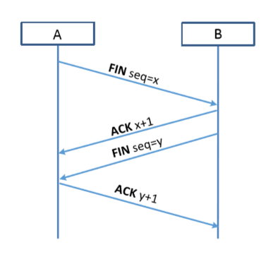
TCP Reset Attack
To disconnect a TCP connection gracefully :
A sends out a “FIN” packet to B
B replies with an “ACK” packet. This closes the A-to-B communication
Now, B sends a “FIN” packet to A and A replies with “ACK”
Using Reset flag (another way to terminate connection between A & B in abnormal/urgent situations) :
One of the parties sends RST packet to immediately break the connection
11

Slide 12
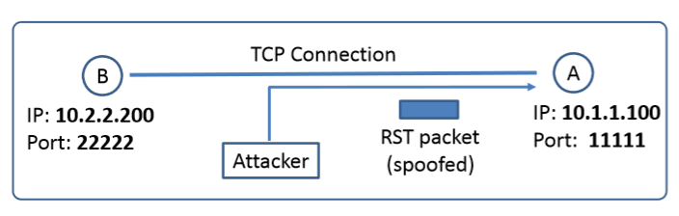
TCP Reset Attack
Goal: To break up a TCP connection between A and B
Spoofed RST Packet: The following fields need to be set correctly:
Source IP address, Source Port, Destination IP address, Destination Port (i.e., 4-Tuple to identify a TCP connection)
Sequence number (within the receiver’s window)
Fun fact: This tampering technique can be used by a firewall or abused by a malicious attacker to interrupt Internet connections.
The Great Firewall of China, and Iranian Internet censors are known to use TCP reset attacks to interfere with and block connections as a major method to carry out Internet censorship.
12

Slide 13
Attack on connect – TCP SYN Flooding
Attack to terminate - TCP Reset Attack
Understanding Cookies
Attack during session – TCP Hijacking Attack
Module 2
Attacks on the TCP protocol

Slide 14


Maintaining user/server state: cookies
Recall: HTTP GET/response interaction is stateless
no notion of multi-step exchanges of HTTP messages to complete a Web “transaction”
no need for client/server to track “state” of multi-step exchange
all HTTP requests are independent of each other
no need for client/server to “recover” from a partially-completed-but-never-completely-completed transaction
a stateful protocol: client makes two changes to X, or none at all
X
lock data record X
X
OK
update X X’
X’
OK
t’
update X X’’
OK
X’’
unlock X
OK
X’’
time
time
Q: what happens if network connection or client crashes at t’ ?
Notes:
t’

Slide 15
Maintaining user/server state: cookies
Web sites and client browser use cookies to maintain some state between transactions
four components:
1) cookie header line of HTTP response message
2) cookie header line in next HTTP request message
3) cookie file kept on user’s host, managed by user’s browser
4) back-end database at Web site
Example:
Susan uses browser on laptop, visits specific e-commerce site for first time
when initial HTTP requests arrives at site, site creates:
unique ID (aka “cookie”)
entry in backend database for ID
subsequent HTTP requests from Susan to this site will contain cookie ID value, allowing site to “identify” Susan
Notes:
t’

Slide 16
Maintaining user/server state: cookies
client
Amazon server
ebay 8734
usual HTTP request msg
Amazon server
creates ID
1678 for user
cookie file
usual HTTP response
set-cookie: 1678
backend
database
create
entry
ebay 8734
amazon 1678
usual HTTP request msg
cookie: 1678
cookie-
specific
action
access
usual HTTP response msg
one week later:
access
ebay 8734
amazon 1678
usual HTTP request msg
cookie: 1678
cookie-
specific
action
usual HTTP response msg
time
time
Notes:
t’

Slide 17
HTTP cookies: comments
aside
What cookies can be used for:
authorization
shopping carts
recommendations
user session state (Web e-mail)
cookies and privacy:
cookies permit sites to learn a lot about you on their site.
third party persistent cookies (tracking cookies) allow common identity (cookie value) to be tracked across multiple web sites
Challenge: How to keep state?
at protocol endpoints: maintain state at sender/receiver over multiple transactions
in messages: cookies in HTTP messages carry state
Notes:
t’

Slide 18




Example: displaying a NY Times web page
1
GET base html file from nytimes.com
2
fetch ad from AdX.com
nytimes.com
4
5
HTTP GET
1
2
HTTP reply
7
display composed page
3
4
6
5
NY times page with embedded ad displayed
AdX.com

Slide 19
Cookies: tracking a user’s browsing behavior
1634: sports, 2/15/22
nytimes.com (sports)
“first party” cookie – from website you chose to visit (provides base html file)
HTTP
GET
HTTP reply
Set cookie: 1634
HTTP GET
Referrer: NY Times Sports
4
5
7493: NY Times sports, 2/15/22
“third party” cookie – from website you did not choose to visit
HTTP reply
NY Times: 1634
Set cookie: 7493
AdX.com
AdX: 7493

Slide 20
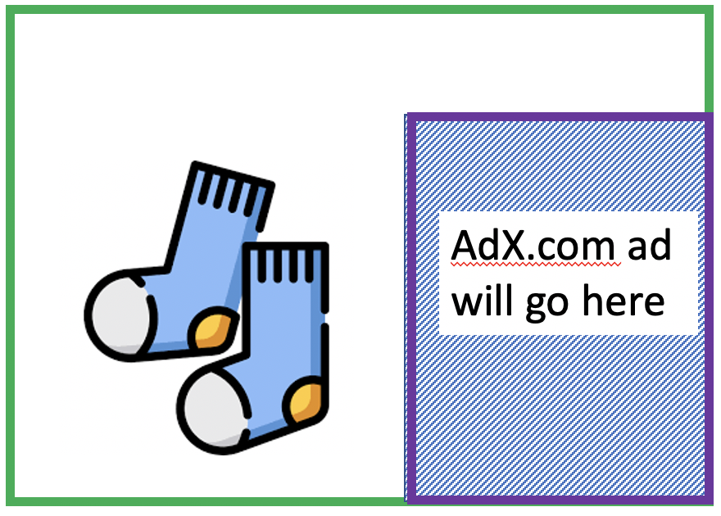
Cookies: tracking a user’s browsing behavior
1634: sports, 2/15/22
nytimes.com
AdX:
tracks my web browsing over sites with AdX ads
can return targeted ads based on browsing history
socks.com
HTTP reply
2
HTTP GET
1
HTTP GET
Referrer: socks.com, cookie: 7493
4
7493: NY Times sports, 2/15/22
5
7493: socks.com, 2/16/22
HTTP reply
NY Times: 1634
Set cookie: 7493
AdX.com
AdX: 7493

Slide 21

Cookies: tracking a user’s browsing behavior (one day later)
1634: sports, 2/15/22
1634: arts, 2/17/22
nytimes.com (arts)
socks.com
HTTP
GET
HTTP reply
cookie: 1634
Set cookie: 1634
HTTP GET
Referrer: nytimes.com, cookie: 7493
4
7493: NY Times sports, 2/15/22
5
7493: socks.com, 2/16/22
HTTP reply
7493: NY Times arts, 2/15/22
NY Times: 1634
Set cookie: 7493
AdX.com
AdX: 7493
Returned ad for socks!

Slide 22


GDPR (EU General Data Protection Regulation) and cookies
“Natural persons may be associated with online identifiers […] such as internet protocol addresses, cookie identifiers or other identifiers […].
This may leave traces which, in particular when combined with unique identifiers and other information received by the servers, may be used to create profiles of the natural persons and identify them.”
GDPR, recital 30 (May 2018)
when cookies can identify an individual, cookies are considered personal data, subject to GDPR personal data regulations
User has explicit control over whether or not cookies are allowed

Slide 23
Attack on connect – TCP SYN Flooding
Attack to terminate - TCP Reset Attack
Understanding Cookies
Attack during session – TCP Hijacking Attack
Module 2
Attacks on the TCP protocol

Slide 24
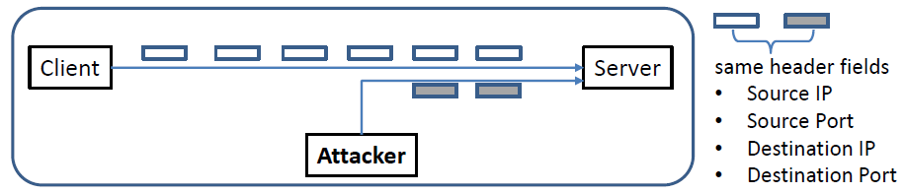
TCP Session Hijacking Attack
Goal: To inject data in an established connection.
(This is different from the DoS attack in TCP SYN Flooding or Reset)
Spoofed TCP Packet: The following fields need to be set correctly:
Source IP address, Source Port,
Destination IP address, Destination Port
Sequence number (within the receiver’s window)
24

Slide 25
TCP Session Hijacking Attack Examples
Zoom bombing
During the Covid-19 pandemic, the world turned to video conferencing apps like Zoom. These apps became a popular target of session hijackers, even earning the nickname ‘zoom bombing’. There were news reports of session hijackers joining private video sessions, in some cases shouting profanities, hateful language and sharing pornographic images. In response, Zoom introduced greater privacy protections to minimize the risk.
Slack
In 2019, a researcher on a bug bounty platform identified a vulnerability in Slack which allowed attackers to force users into fake session redirects so they could steal their session cookies. This gave attackers access to any data shared within Slack (which for many organizations, can be significant). Slack was quick to respond and patched the vulnerability within 24 hours of the researcher highlighting it.

Slide 26
Defending Against Session Hijacking
Making it difficult for attackers to spoof packets
Randomize source port number
Randomize initial sequence number
Note: Randomization is NOT effective against local attacks that can sniff packets and determine this information
Encrypting payload
26

Slide 27
TCP fundamental
Attacks on the TCP protocol
Denial-of-Service attack
SQL injection attack
Cross-side scripting attack
Miscellaneous: Heartbleed bug and attack, Ransomware, Cryptojacking
Module 2

Slide 28
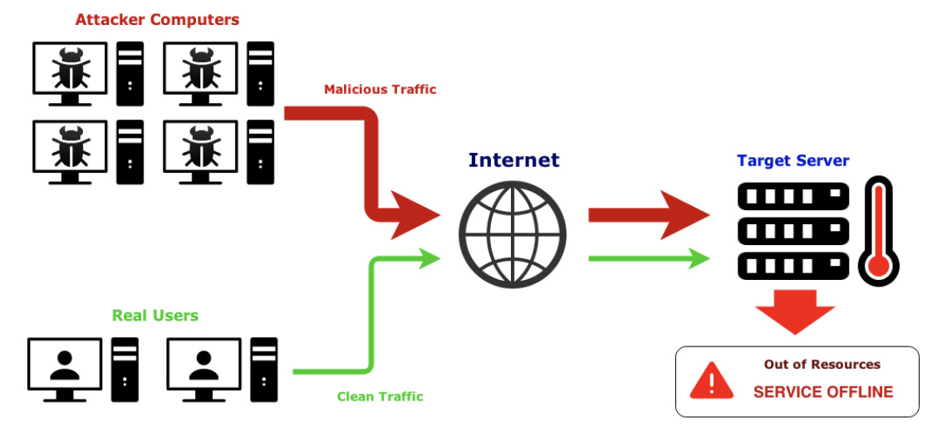
Denial-of-Service (DoS) Attack
A denial of service (DoS) is an action that prevents or impairs the authorized use of networks, systems, or applications by exhausting resources such as central processing units (CPU), memory, bandwidth, and disk space
A form of attack on the availability of a service; focus is generally on network services that are attacked over their network connection
28

Slide 29
DoS Attack - Facts
One of the most common types of attacks
Aims to prevent users from accessing system
Requires a minimum of technical skill
Effective because computers and other systems have physical limitations
Number of simultaneous users
Size of files
Speed of data transmission
Amount of data stored

Slide 30
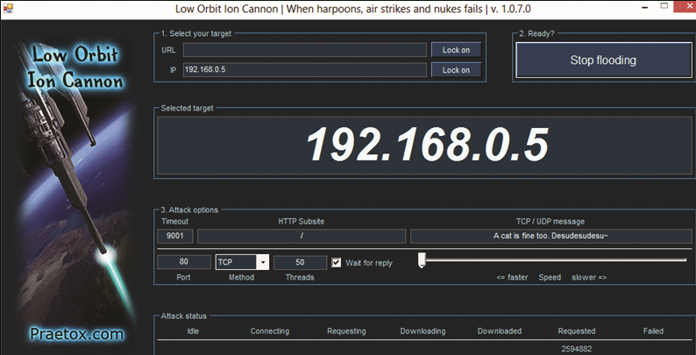
Common Tools Used for DoS Attacks
Low Orbit Ion Cannon (LOIC)

Slide 31

Common Tools Used for DoS Attacks
High Orbit Ion Cannon (HOIC)

Slide 32
SEED Lab 2: TCP attacks Walkthrough
Submission Due: Feb. 16th

